Slide 1
RATINGS PREDICTION PROJECT
Submitted by:
JASMINE KAUR

Slide 2
INTRODUCTION
This is a Machine Learning Project performed on customer reviews. Reviews are processed using common NLP techniques.
Millions of people use Amazon to buy products. For every product, people can rate and write a review. The ratings range between 1 and 5, where 1 being a poor rating and 5 being an excellent rating. Our aim in this project is to predict star rating automatically based on the product review.
This task is similar to Sentiment Analysis, but instead of predicting the positive and negative sentiment (sometimes neutral also), here we need to predict the rating.

Slide 3
MATHEMATICAL / ANALYTICAL MODELLING OF THE PROBLEM
In our scrapped dataset, our target variable "Rating " is a categorical variable i.e., it can be classified as ‘1.0’, ‘2.0’,’3.0’,’4.0’,’5.0’. Therefore, we will be handling this modelling problem as classification.
This project is done in two parts:
Data collection phase
Model Building phase

Slide 4
Continued
In Data collection phase, we will scrape nearly 50000 of reviews data from different e-commerce websites like Amazon and it is collected by using Webscraping and Selenium.
After collecting the data, you need to build a machine learning model. Before model building do all data pre-processing steps involving NLP. Try different models with different hyper parameters and select the best model. Follow the complete life cycle of data science. Include all the steps like-
1. Data Cleaning
2. Exploratory Data Analysis
3. Data Pre-processing
4. Model Building
5. Model Evaluation
6. Selecting the best model

Slide 5
DATA INFORMATION
There are null values in the data. It is treated by substituting the average value in the ratings column.
There were more than desired categories in the ratings column, so we removed all other than the desired one.

Slide 6
Pre-processing using Natural Language Processing (NLP):
We cleaned the data using regex, matching patterns in the comments and replacing them with more organized counterparts. Cleaner data leads to a more efficient model and higher accuracy. Following steps are involved:
1. Removing Punctuations and other special characters
2. Splitting the comments into individual words
3. Removing Stop Words

Slide 7
Continued…
We will be tokenizing the data using RegexpTokenizer
Stemming is the process of converting inflected/derived words to their word stem or the root form.
Lemmatizing is the process of grouping together the inflected forms of a word so they can be analyzed as a single item.
Then, we will be processing the review and assigning the updated review in the data frame
Finally, we get sense of words for all ratings using WordCloud. Word Cloud is a data visualization technique used for representing text data in which the size of each word indicates its frequency or importance.

Slide 8
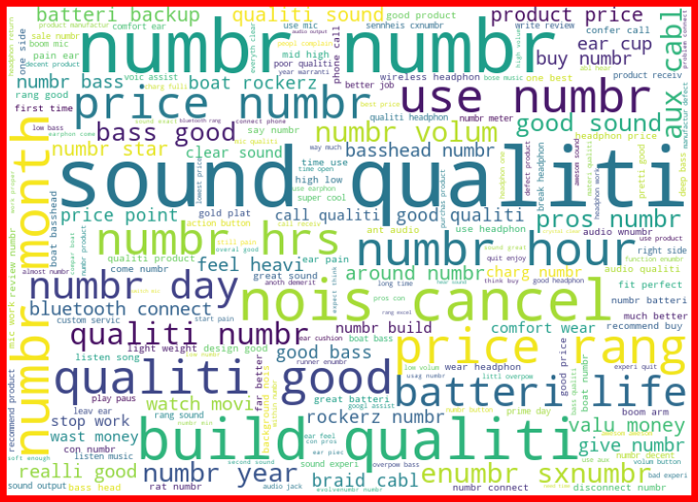
Example of word cloud

Slide 9
HARDWARE AND SOFTWARE USED
For doing this project, the hardware used is a laptop with high end specification and a stable internet connection. While coming to software part, I had used anaconda navigator and in that I have used Jupyter notebook to do my python programming and analysis.
For using an CSV file, Microsoft excel is needed. In Jupyter notebook, we have used lots of python libraries to carry out this project.

Slide 10
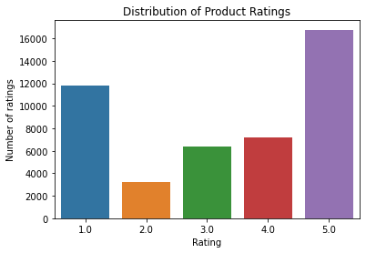
DATA VISUALIZATION This shows the frequency of different categories present in the dataset.

Slide 11
ALGORITHMS
We have used following algorithms:
LogisticRegression
MultinomialNB
DecisionTreeClassifier
KNeighborsClassifier
RandomForestClassifier
AdaBoostClassifier
GradientBoostingClassifier

Slide 12
FINAL MODEL
After comparing the model, we have got the accuracy score and cross validation model. The best scores come out to be Adaboost Classifier.
We have performed hyperparameter tuning on adaboost classifier and saved the model.

Slide 13
CONCLUSION
The problems we faced during this project were:
More time consumption during hyperparameter tuning for both models, as the data was large.
Less number of parameters were used during tuning.
Scrapping of data from different websites were of different process and the length of data were differing in most cases.
Some of the reviews were bad and the text had more wrong information about the product.
WordCloud was not showing proper text which had more positive and negative weightage.
Areas of improvement:
Less time complexity
More computational power can be given
Errors can be avoided.

Slide 14
THANK YOU

